Slide 1
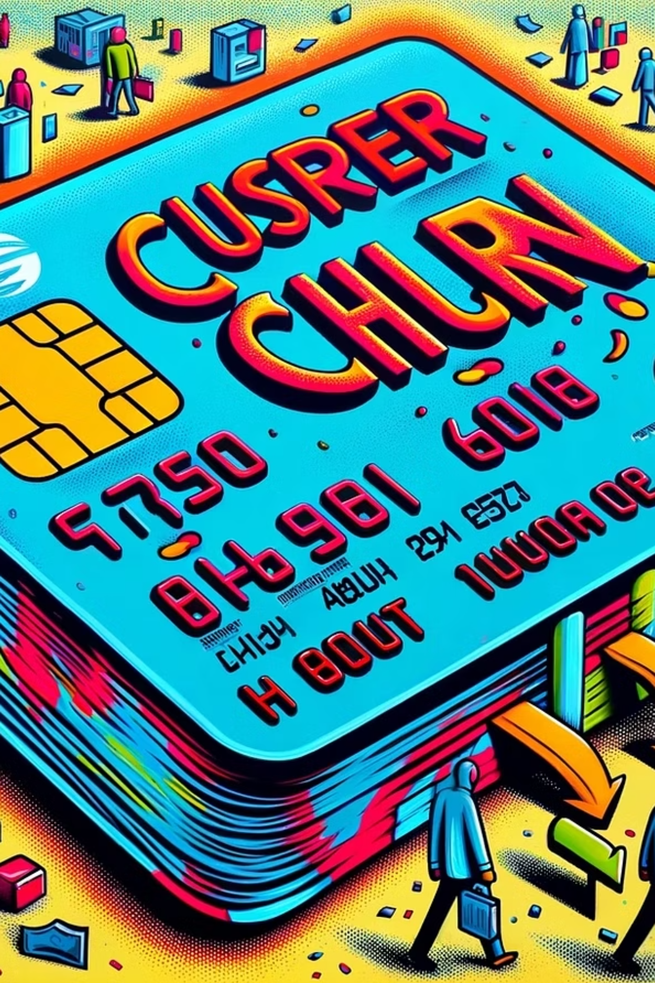
Credit Card Churn User Prediction
This report explains how a machine learning (ML) model was used to predict which credit card customers might stop using the service. It looks at customer data to find signs of possible churn, helping businesses take steps to keep those customers and reduce losses.
Presented by:
Romit Soni
GitHub Link: https://github.com/romitsoni/credit-card-churn-analysis

Slide 2


Overview
Project Purpose
Business Value
Using machine learning to predict which credit card customers might stop using the service
Identifying signs of possible churn, helping businesses take steps to keep those customers and reduce losses
Approach
Analysis of customer data through data cleaning, feature engineering, exploratory data analysis, and model training

Slide 3

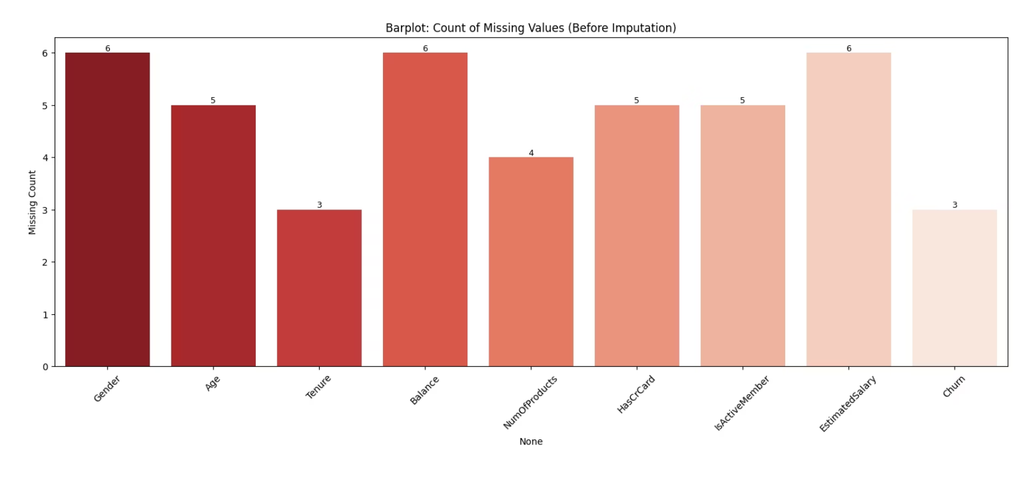
Data Cleaning Process
Initial Data Loading
Dataset: exl_credit_card_churn_data.csv containing customer information
Analyzed dimensions and column structure
Comprehensive check for null values across all columns
Imputed missing values with median and mode
Bar Plot of Missing Values Before Imputation

Slide 4

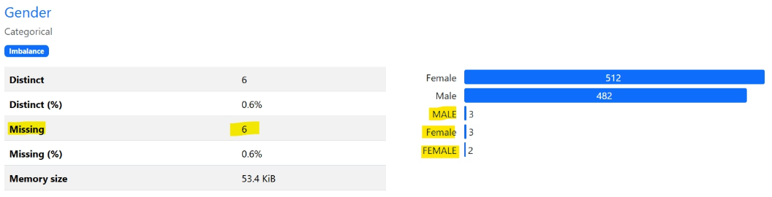
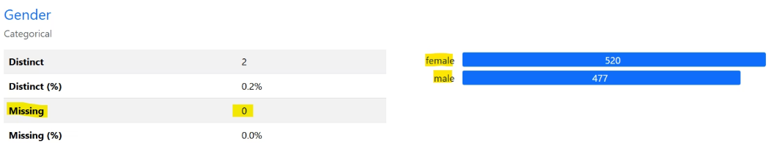
Gender Column Cleaning
Problem Identified:
Before Cleaning:
Before Cleaning:→
Inconsistent string representations
5 distinct values
'nan' values present
6 missing values (0.6%)
Solution Applied:
Inconsistent formats: Female, MALE, male
Converted all values to lowercase
After Cleaning:→
After Cleaning:
Standardized gender representation
Imputed missing values with mode imputation
2 distinct values: female (520), male (477)
0 missing values

Slide 5
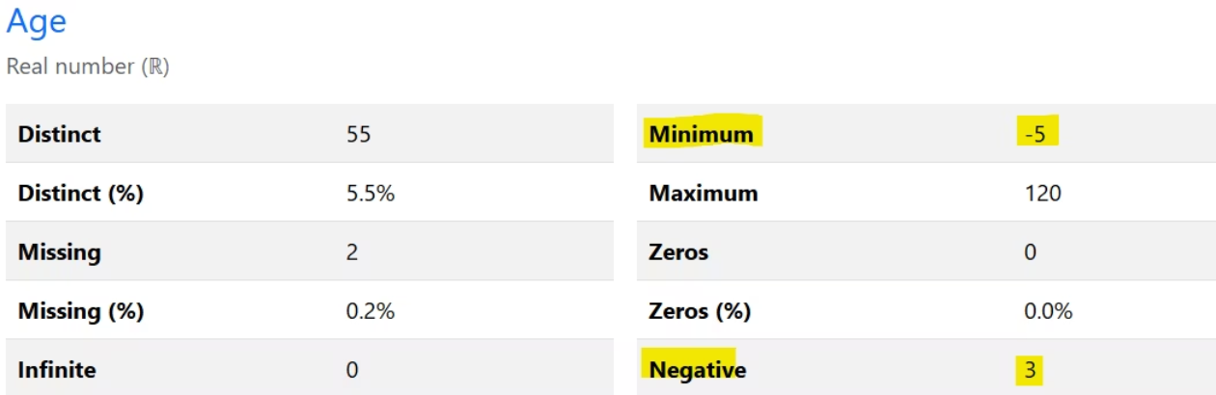
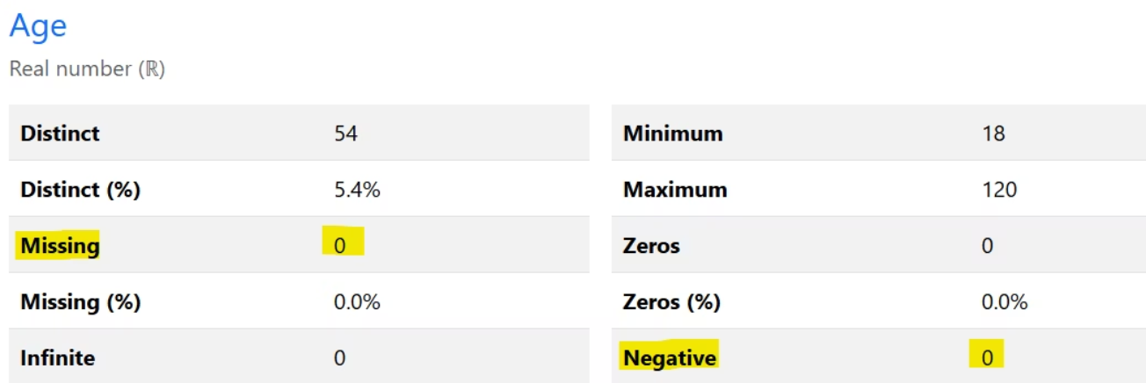
Age Column Cleaning
Problem Identified:
Before:→
Negative age values found in the dataset
Missing age values present
Solution Applied:
Identified rows with Age < 0
Replaced negative ages with np.nan
After:→
Imputed missing values with median

Slide 6
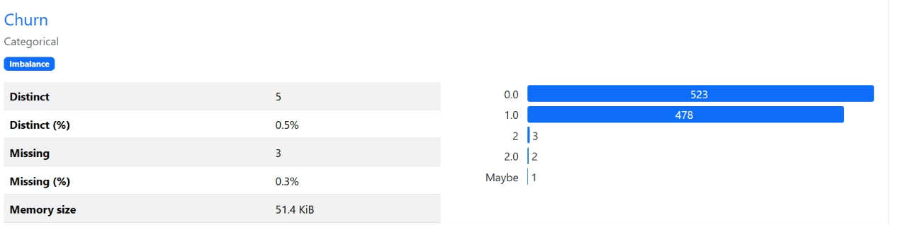
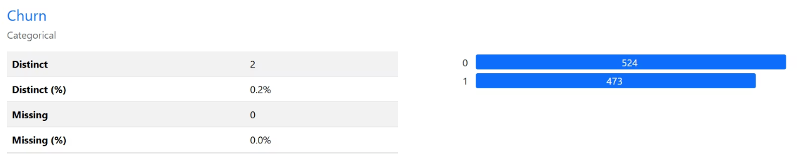
Churn Column Cleaning
Problem Identified:
Before Cleaning:
Before Cleaning:→
Mixed representations of churn status in the dataset
5 distinct values
3 missing values (0.3%)
Solution Applied:
Mapped: '1', '1.0' → 1
After Cleaning:
After Cleaning:→
Mapped: '0', '0.0', '2', '2.0', 'maybe' → 0
2 distinct values: 0 (524), 1 (473)
Ensured binary classification format
0 missing values

Slide 7

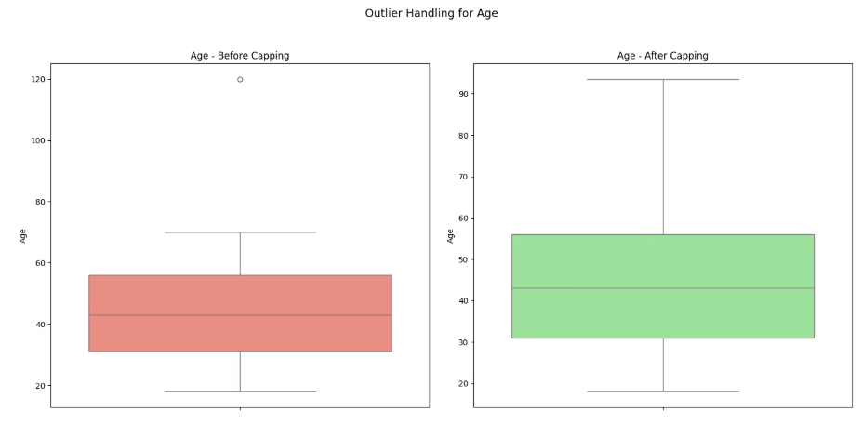
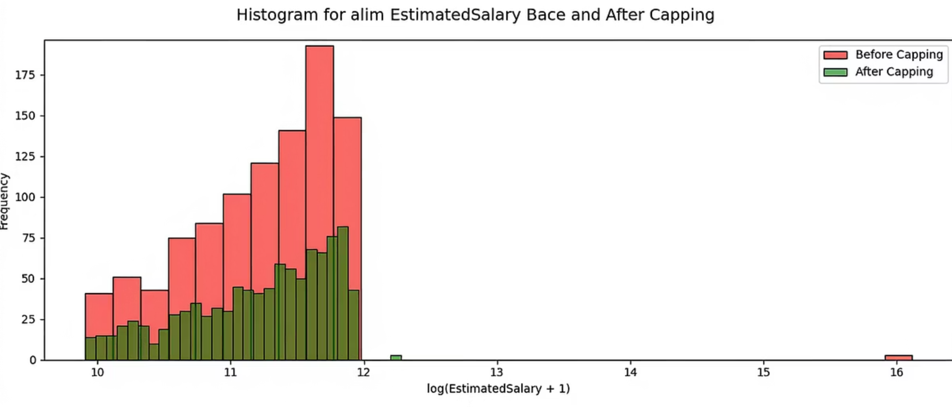
Outlier Detection and Handling
Method Used:
IQR (Interquartile Range) Capping
Process:
Identified outliers in: Age, Balance, EstimatedSalary, NumOfProducts
Box Plots showing before and after outlier capping comparison for age
Applied 1.5×IQR rule for boundary detection
Capped extreme values instead of removing rows

Slide 8
Feature Engineering
Financial Features
Categorical Features
Risk Features
BalancePerProduct: Balance efficiency per product owned
AgeBand: Age groups (18-29, 30-39, 40-49, 50-59, 60+)
HighValueCustomer: Top 25% by balance or salary
SalaryPerProduct: Spending capacity per product
TenureBand: Relationship length (New, Medium, Long)
CustomerRiskScore: Composite risk indicator (0-1 scale)
BalanceToSalaryRatio: Financial health indicator
ActivityLevel: Engagement level (Low, Medium, High)
HasZeroBalance: Flag for zero balance customers
LogBalance & LogSalary: Log-transformed financial features
IsSingleProduct: Flag for single product users

Slide 9
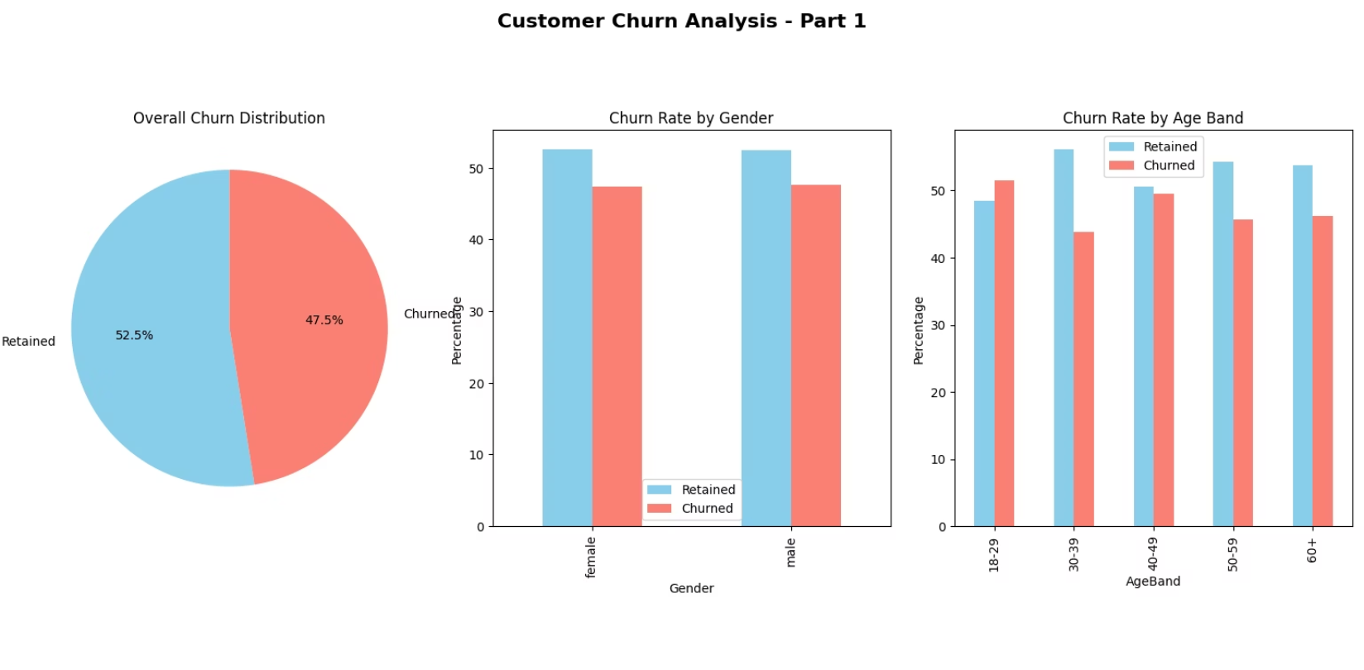
Exploratory Data Analysis (EDA)
Key Findings:
Overall Churn Rate: Calculated percentage of customers who churned vs. retained
Class Balance: Assessed whether the dataset has balanced or imbalanced target classes
Around 47.5% of customers have churned
Both males and females have similar churn patterns
Younger (18–29) age groups churn more. Middle-aged groups (30–59) have higher retention. Age impacts churn

Slide 10

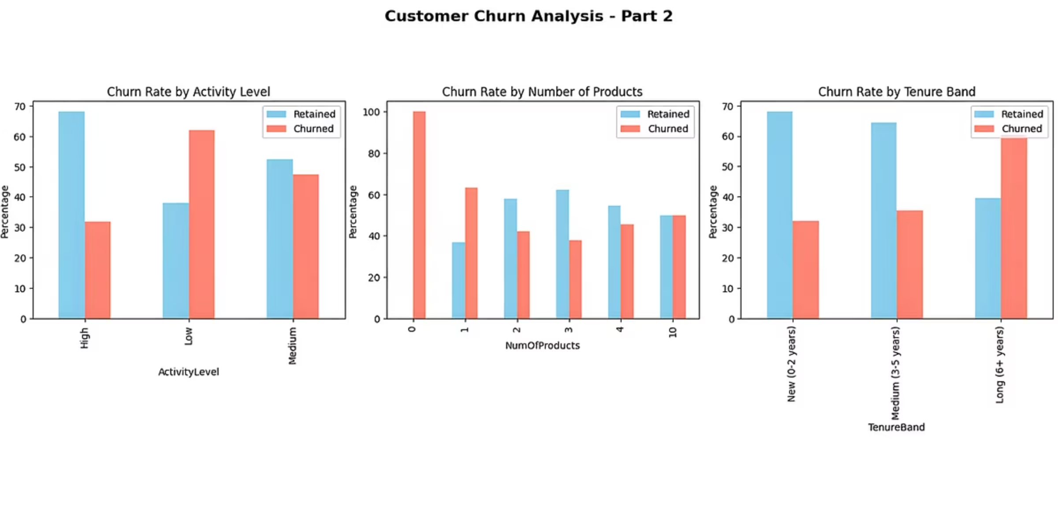
Behavioral Insights
Activity Level Impact
Product Count Effect
Highly active customers are more likely to stay. Low activity customers churn the most. Shows that customer engagement plays a big role in retention.
Customers with only 1 product have the highest churn. Churn decreases as product count increases. Suggests that offering more products can improve loyalty.

Slide 11
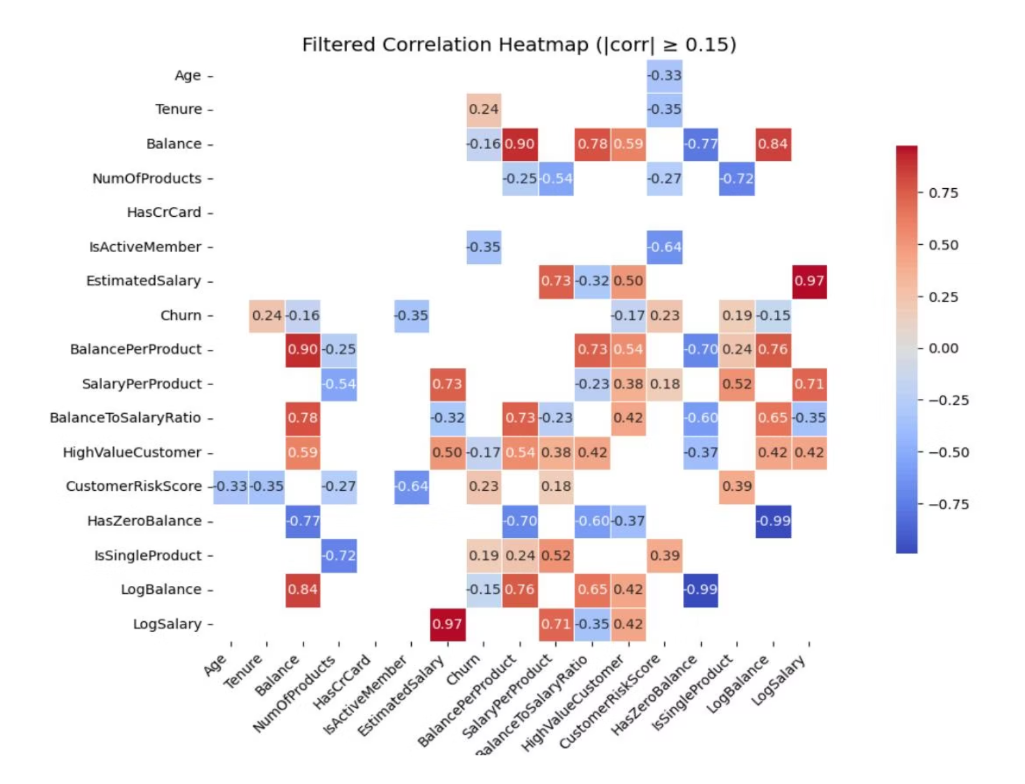
Correlation Analysis
Filtered Correlation Heatmap:
Shows only strong relationships (correlation above 0.15)
Helps focus on patterns that matter most
Reveals how features like balance or salary relate to churn
Hides weak or unimportant connections to reduce confusion

Slide 12

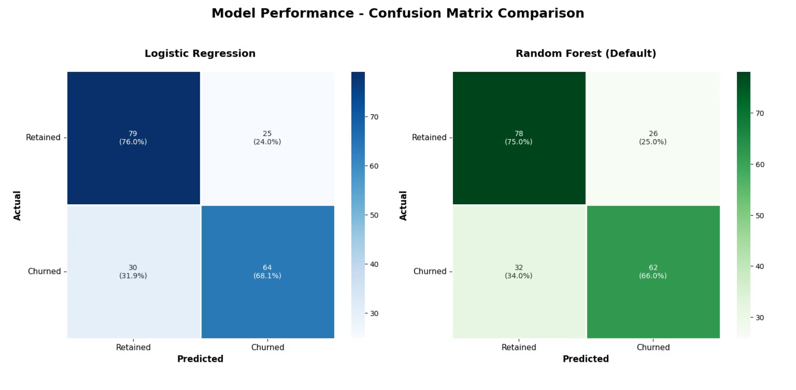
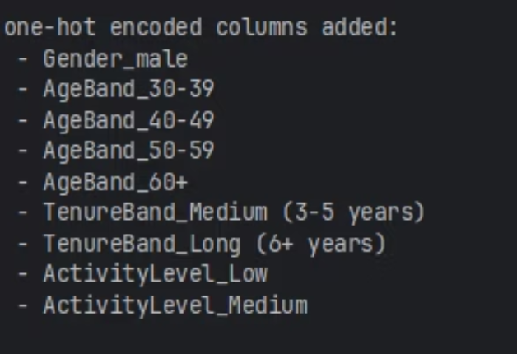
Model Training and Evaluation
Data Preparation:
Applied one-hot encoding to categorical variables
Encoded: Gender, AgeBand, TenureBand, ActivityLevel
Applied MinMaxScaler to all numerical features
Split Ratio: 80% training, 20% testing
Models Tested:
Confusion Matrix Observations:-> Logistic Regression Correctly predicted 79 retained customers (76%)
Logistic Regression
Random Forest
Correctly predicted 64 churned customers (68.1%)
Misclassified 25 retained as churned
Misclassified 30 churned as retained
Random Forest: Correctly predicted 78 retained customers (75%) Correctly predicted 62 churned customers (66%)
Misclassified 26 retained as churned
Misclassified 32 churned as retained

Slide 13

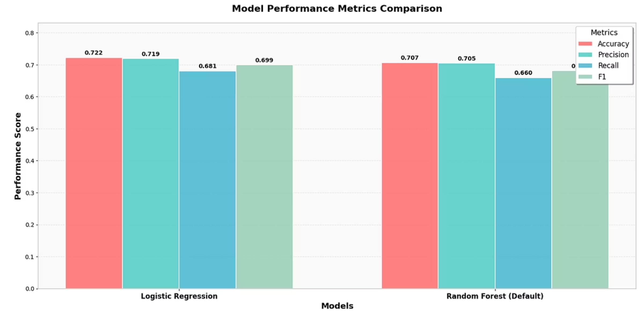
Model Performance Comparison
Logistic Regression:
Random Forest (Default):
Accuracy: 72%
Accuracy: 71%
Churn Precision (class 1): 0.72
Churn Precision: 0.70
Churn Recall: 0.68
Churn Recall: 0.66
F1-Score (churn): 0.70
F1-Score (churn): 0.68
Performs slightly better at identifying churned customers
Slightly lower recall -> misses more churners
Balanced performance across both classes

Slide 14
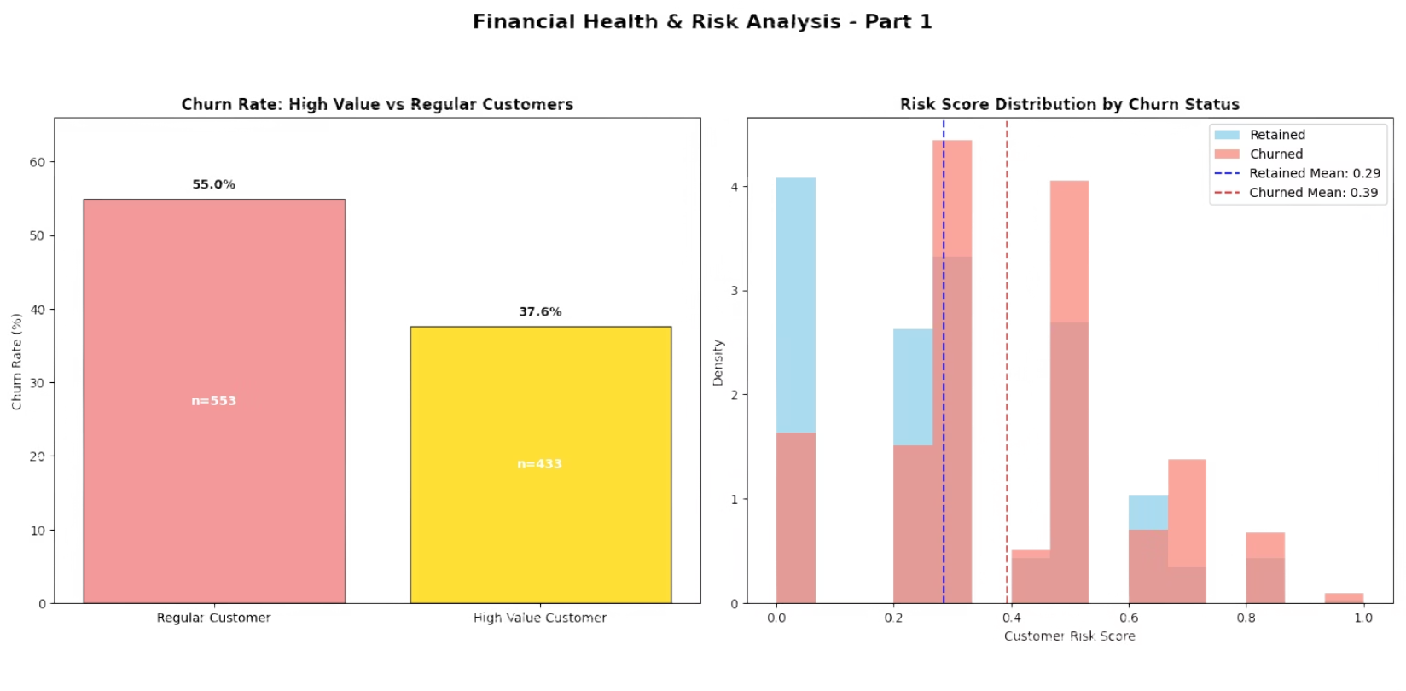
Business Insights - Customer Segments
High-Risk Customer Segments:
Single Product Users: Highest churn risk group
Young Customers (18-29): Need targeted retention
Low Activity Customers: Require engagement programs
Risk Score Distribution by Churn Status
Average risk score is higher for churned customers (0.39) vs retained customers (0.29).
Retained customers are clustered more in the low-risk zone (0.0 to 0.3).
Regular customers churn more (55%) than high-value ones (37.6%). Churned customers have a higher mean risk score (0.39) than retained customers (0.29).

Slide 15

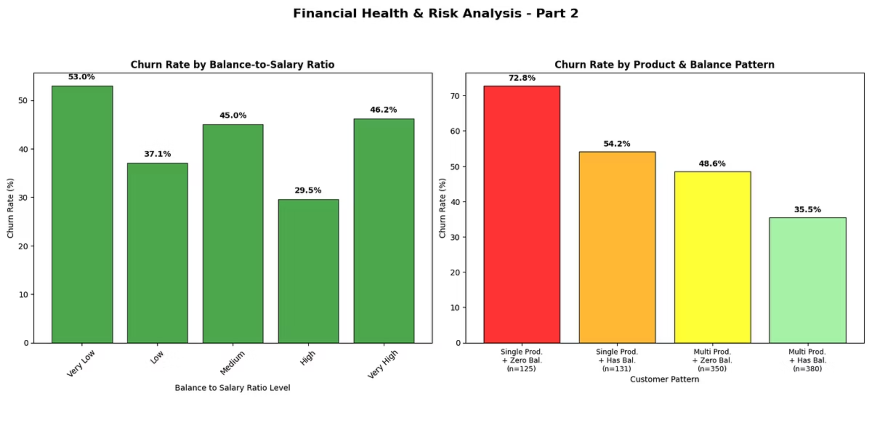
Business Insights - Financial Patterns
Balance-to-Salary Ratio Impact
Very Low ratio → Highest churn (53%) → Financially strained customers
High ratio → Lowest churn (29.5%) → Strong financial buffer
Customers with a good balance-to-salary ratio are more likely to stay
Product & Balance Pattern
Single Product + Zero Balance → Extreme churn (72.8%)
Adding balance or products significantly lowers churn
Multi Product + Has Balance → Lowest churn (35.5%)
Shows that having more products and a positive balance helps keep customers from leaving

Slide 16

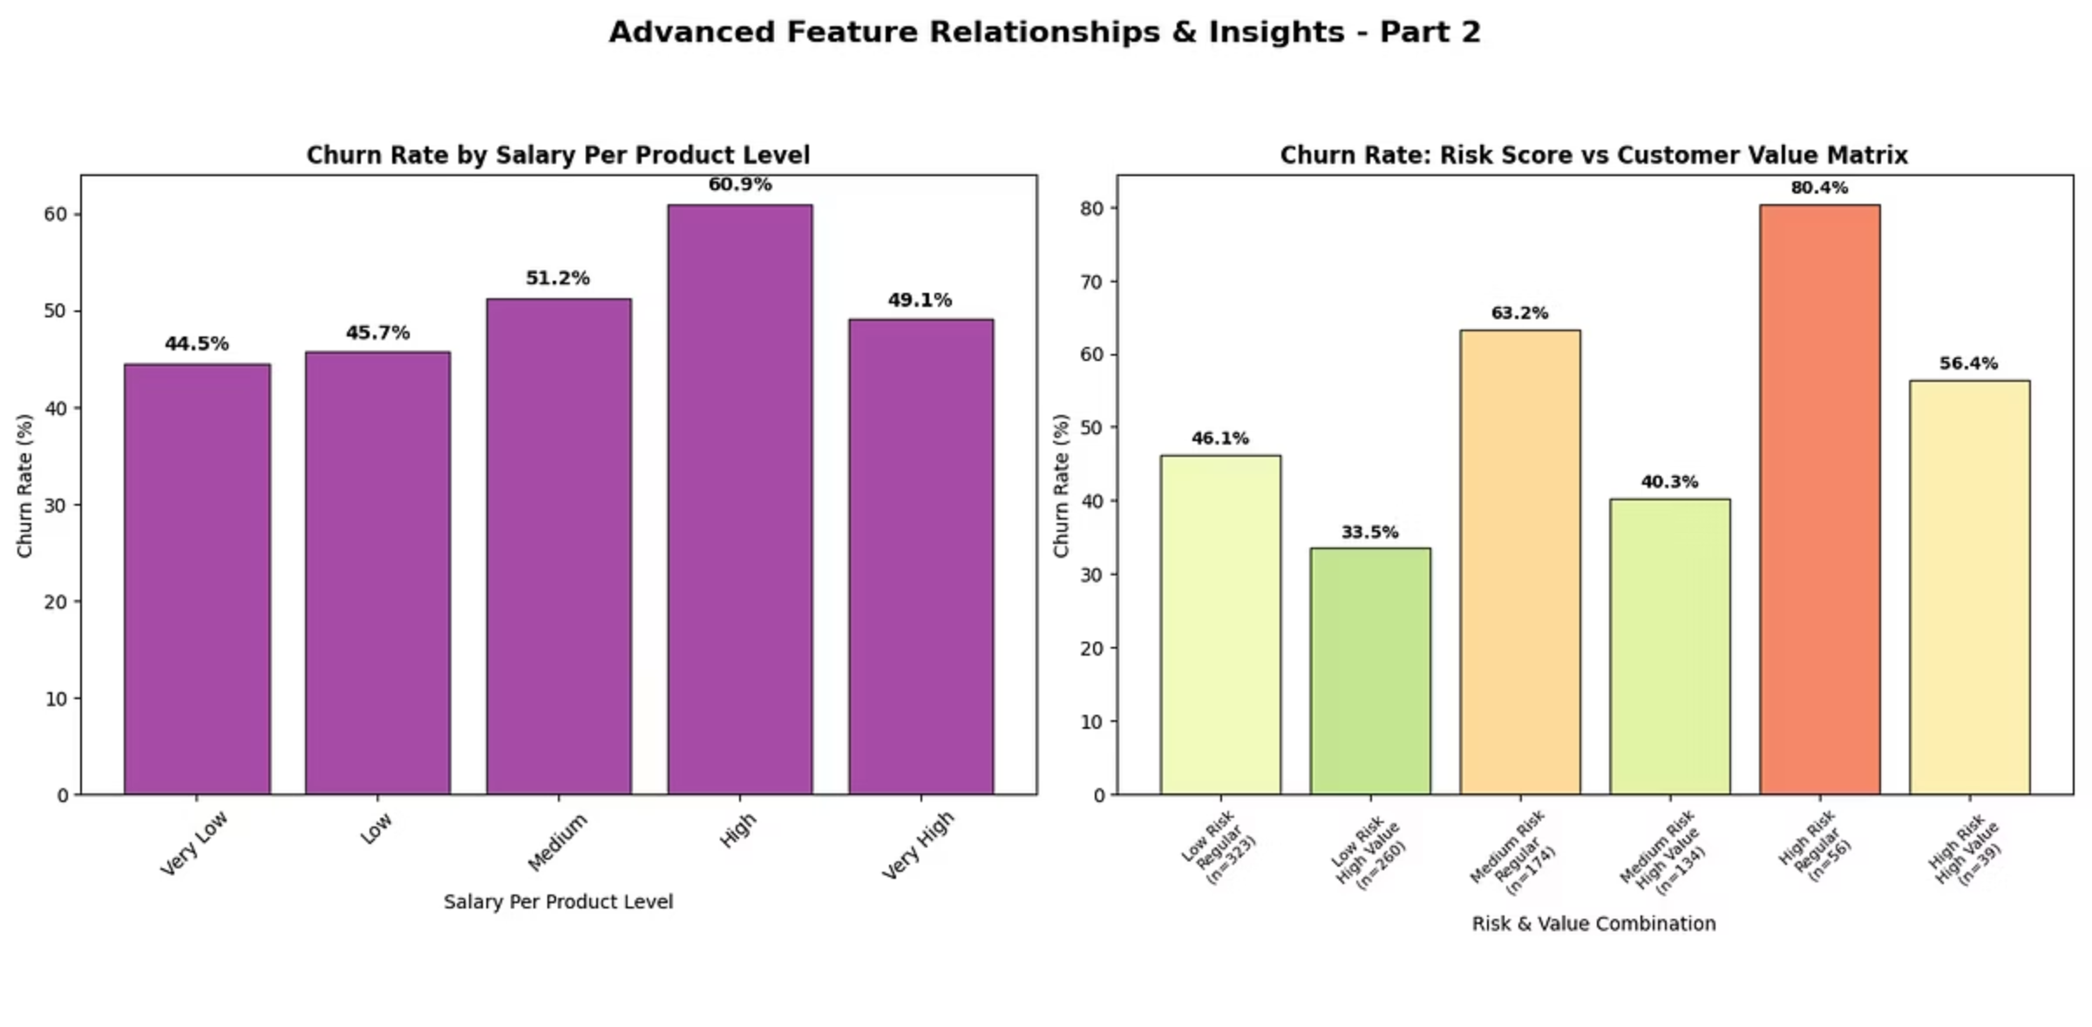
Business Insights – Income & Risk Patterns
Churn Rate by Salary Per Product Level (Left Chart)
Customers with higher income per product are more likely to churn.
Churn steadily increases from 44.5% (Very Low) to 60.9% at the High level.
Surprisingly, even Very High salary per product doesn't mean low churn → still 49.1% churn.
Churn Rate: Risk Score vs Customer Value Matrix (Right Chart)
High Risk + Regular Value customers show the highest churn rate: 80.4% → urgent focus group.
High Risk + High Value also churn at 56.4% → still concerning. Best segment:
Low Risk + High Value churns the least at 33.5% → shows potential for loyalty.
Medium and Low risk customers generally churn less, regardless of value level.

Slide 17
Thank You

